Slide 1


Slide 2

Agenda
Welcome & Introductions
ICC Logistics
  Allison Thompson, Shannon Shelton-Muller, Linda Briggs
Contestant Information
  Linda Hilko, Margaret Cain
Attendee Information
  Marie Ross, Ruth Maple
Activities
  Gaye LaCasce, Tessa Walker, Samantha Tramack, Wendy Spilker
Volunteering
  Deb Wilson
ICC Resources
  Debbie Glenn
Q&A

Slide 3

Convention Team
Convention Manager
Allison Thompson
iccmanager@harmonyinc.org
Contest/Stage Manager
Linda Hilko
ICCContestManager@harmonyinc.org
On-Site Manager
Marie Ross
ICCOnsiteManager@harmonyinc.org
Registration Manager
Linda Briggs
ICCRegistrar@harmonyinc.org
Award/Services Manager
Margaret Cain
ICCServicesMgr@harmonyinc.org
Volunteer Manager
Debbie Wilson
ICCVolunteerManager@harmonyinc.org
Marketing Assistant
Shannon Shelton-Muller
ICCMarketingAsst@harmonyinc.org
Convention Team Assistant
Debbie Glenn
ICCTeamAssistant@harmonyinc.org
Business Services Assistant
Ruth Maple
ICCBusinessAsst@harmonyinc.org

Slide 4

Logistics

Slide 5

IC&C Agenda Overview
Friday, November 10
9:00 am – Chorus Contest
7:00 pm – Minor Chords Rehearsal
7:30 pm – AHQ reception
8:30 pm – Parade of Champions
Saturday, November 11
8:30 am – Education Classes
9:30 – Minor Chords Rehearsal
11:00 am – Quartet Finals
6:00 pm – Dinner
8:00 pm – Showcase of Champions
10:00 - Hospitality
Wednesday, November 6
2:00 pm – Registration & Harmony Mall open
3:00 pm – IBOD Installation & Reception
4:00 pm – Quartet Stage Viewing
5:00 pm – Chorus Stage Viewing
7:00 pm - Opening Celebration
9:30 pm –Sing with the Queens
Thursday, November 9
9:00 am – Education classes
11:30 am - Quartet Semi Finals
7:30 pm – International Chorus Rehearsal
8:30 pm – Tag Contest
All times are subject to change

Slide 6

Livestream
Harmony Incorporated Stream
$40 for the full streaming package
  All contests
  Opening Celebration
  Parade of Champions
  One week to access the recordings of all of the above
$20 for replays only
  One week to access all the recordings listed above
  On the Sunday of the convention, the website automatically switches to the $20 price point

Slide 7

Convention App
Everything you need to know will be at your fingertips!
Access the full agenda and chat with other attendees.
Instructions on how to download and use the app will be sent out prior to IC&C.
Programs will be made available in advance to print or view online in addition to daily sheets with contestant info.
You can order a printed program for $5 when you purchase your AEP.

Slide 8

Travel
The closest airport is Harrisburg International Airport (MDT)
Uber, Lyft and GoVysh are the ridesharing providers at HIA.
  Passengers will meet their driver on the 3rd floor of the parking garage, in the designated passenger pick up zone.
Click here to see other ground transportation options available including taxis, busses and car services
If you are driving, click here for directions to the hotel
Complimentary self parking is available onsite

Slide 9


Hotel Reservations
Hershey Lodge
Double Double or King:
  $179 + 11% tax = $198.69 USD
Reservations must be accompanied by a valid major credit card to hold the room.
Cancel 3 days prior to arrival to avoid one night charge plus tax.
Check-in is 4:00 PM ET. Check-out time is 11:00 AM ET.
Members are required to stay at the convention hotel or pay the Fair Share Assessment Fee of $199.
Reservation deadline is September 17, 2025.
Step one: fill out form
Step two: Watch email for confirmation number (could take 5-7 days)
Step three: call hotel at 855.729.3108 to make deposit payment

Slide 10

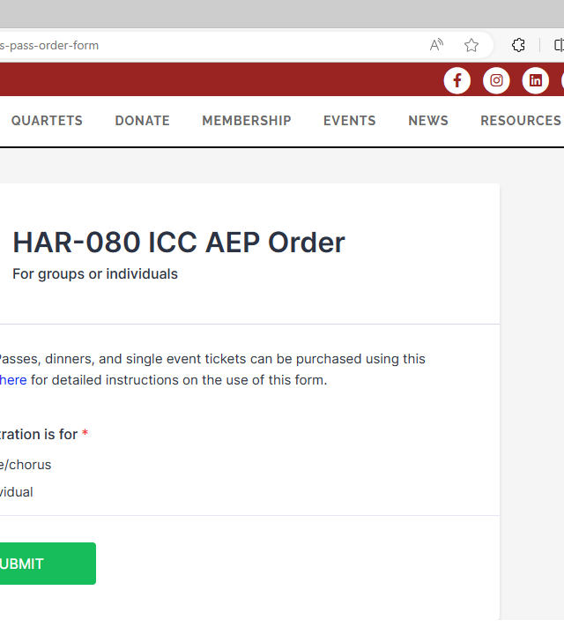
AEP Purchase
We ask that all choruses register their members at the same time versus having members register individually.
Order your AEP’s, dinners, printed programs and individual tickets online here
Preferred method of payment is Zelle (US), E-transfer (Canada).
  Other options include PayPal (US), check or money order
  All prices are in US funds but may be paid in Canadian equivalent with exchange calculated on the day of payment.
Order by August 31 @ midnight ET to enjoy the below discounted pricing. After this time all prices will increase by $10.
  Adult Performing Member AEP = $195
  Adult Non-Performing Member AEP = $148
  Adult Non-Member AEP = $158
  Youth Performing Member AEP = $0*
  Youth Non-performing Member AEP = $0*
  Youth Non-Member AEP = $112
  Single Event Tickets = $35
  Single Event Youth/Child Ticket = $20
  (25 and under / 12 and under free)
If you purchase an AEP, then can no longer attend, you can sell your AEP using our self-serve ticket transfer website
  *this cost is covered by the Steve Hagerdon Bright Future Fund
If you have a favorite lanyard - don’t forget to bring it with you!

Slide 11

DEADLINES
August 31 @ midnight EST
  End of early bird AEP pricing
  Last day for contest entry
October 1
  Dinner Registrations
  Order a printed program
  Big Screen Ads
October 31, midnight EST
  Online Registration (you may still purchase AEPs and tickets at the door)

Slide 12

Registration
Wednesday
  2:00 – 6:30 pm
  9:00 – 10:00 pm After Opening Celebration
Thursday
  8:30 am – 8:30 pm
Friday
  7:30 am – 8:30 am

Slide 13
Contestants

Slide 14
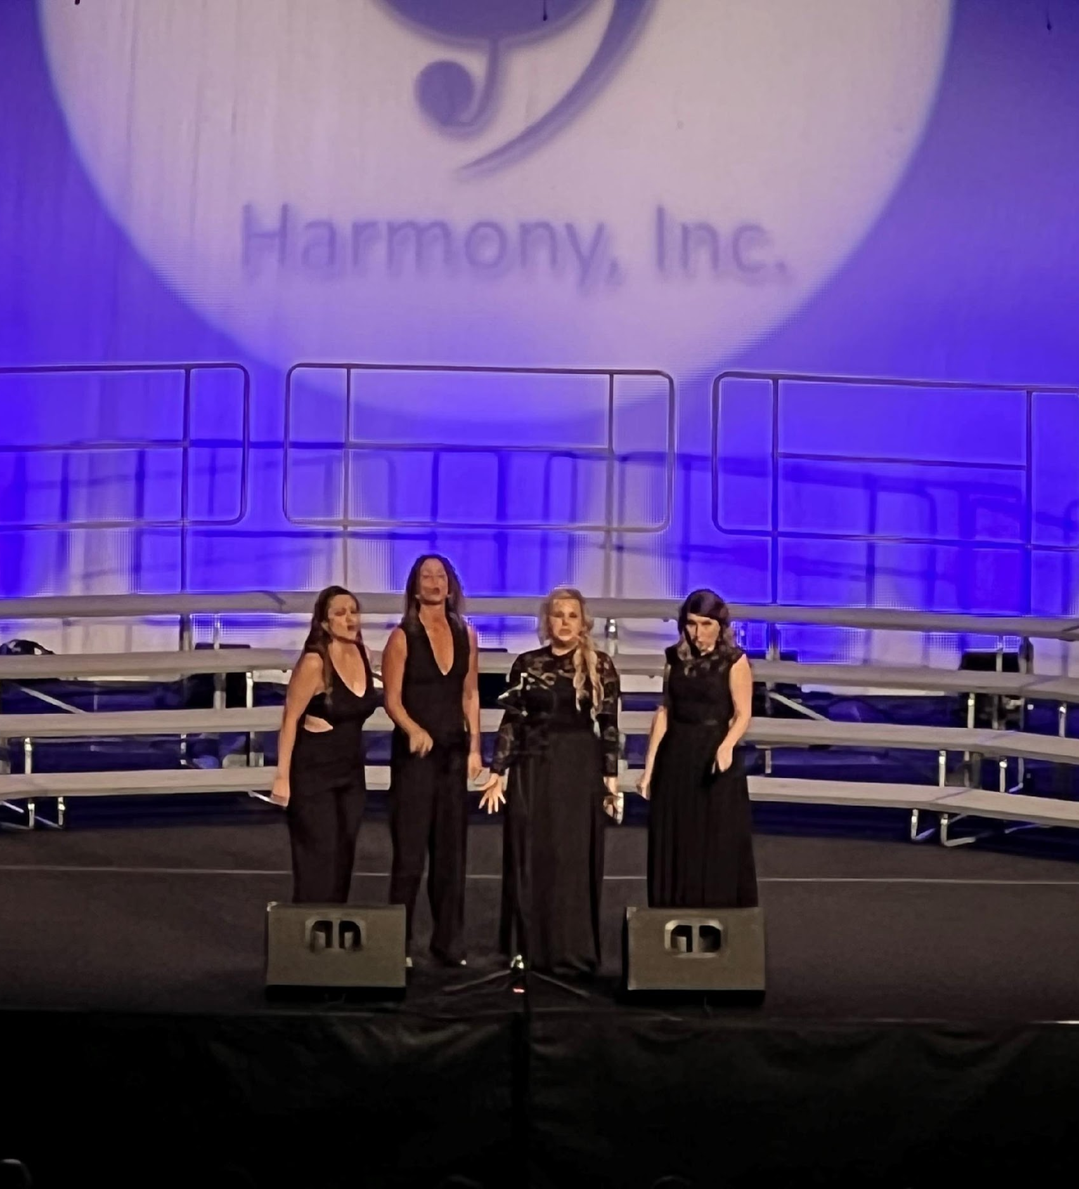

Contestants
Contestants must submit a song registration form by October 7, 2025.
The order of appearance will be announced LIVE September 4 @ 7:30 pm ET.
ICJC will send the contest pattern and related information to each competitor.
We encourage all contestants to not bring your personal belongings with you in the pattern.
Chorus photos will be taken on stage. A member of the chorus will have the option to meet with the photographer after contest to pick their official photo.

Slide 15
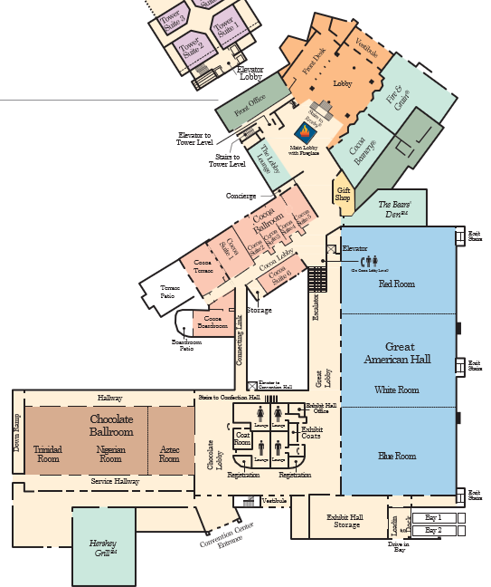
Contest Pattern
Meet on the ground floor near the gift shop.
Warm Up 1
Photo Room
Warm Up 2

Slide 16
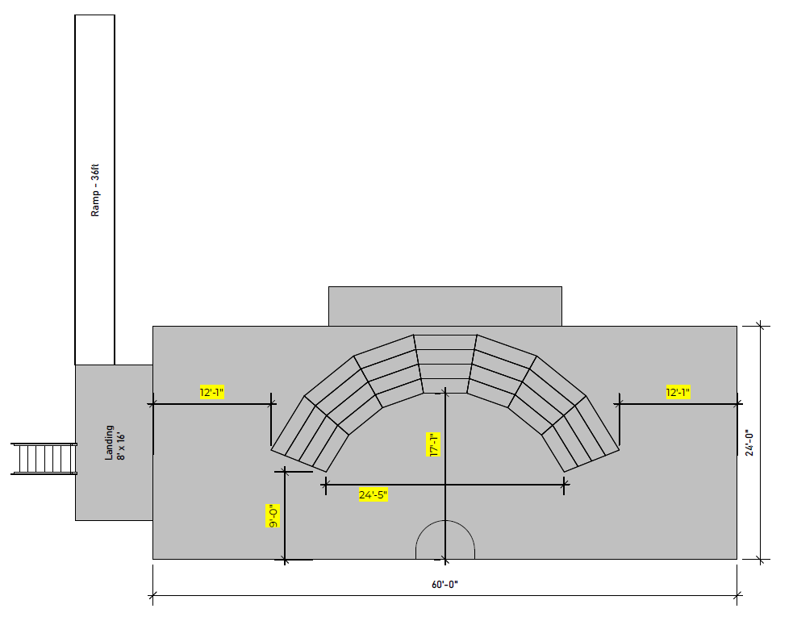
Stage Diagram

Slide 17
Panel
We will have one panel judging all of the contests.
We will only be printing the Official Scoring Summary for contestants (one per quartet, four per chorus).
Scores will be posted online shortly after each contest as well as posted in the mobile app.
ADM | MUS | PER | SNG
Chris Buechler (PC) | Steve Armstrong | Marty Lovick | Jay Butterfield
Alan Lamson | John Burri | Gary Steinkamp | Alan Gordon
 | Adam Scott | Theresa Weatherbee | Steve Scott

Slide 18
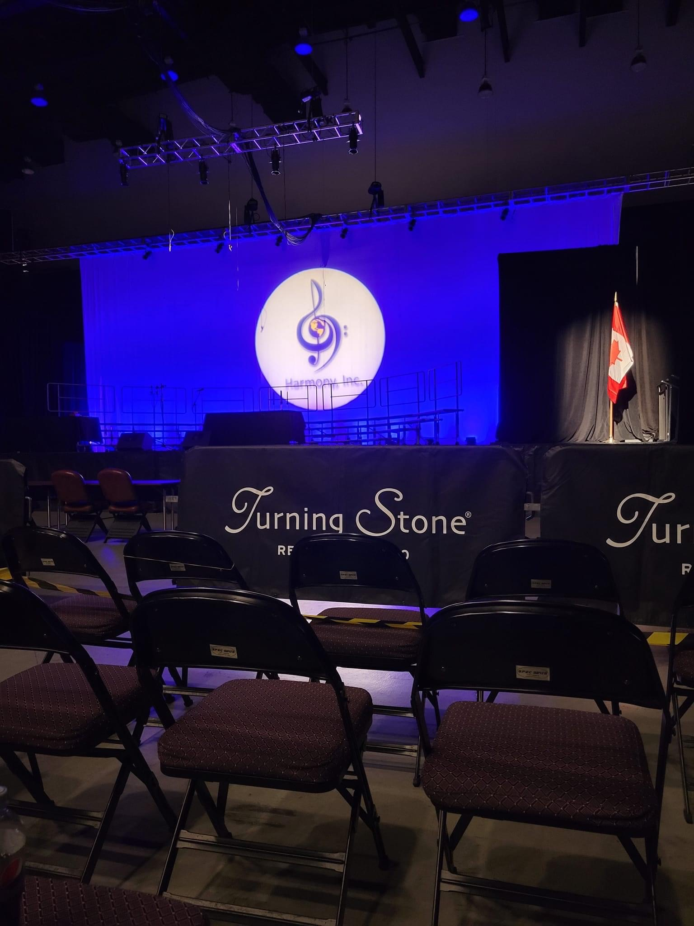
Stage Viewing
Due to the size of our contests, and time constraints, we are not able to allow all choruses and quartets time to practice on the actual stage.
We are able to offer a brief stage “viewing” which will allow up to five people from a chorus and quartets to walk onto the stage.
There is no singing allowed during this time.
4:00 pm – Quartets
5:00 pm - Choruses
The viewing will start with a briefing and Q&A – so be on time!

Slide 19

Rehearsal Rooms
All choruses will have an opportunity to schedule rehearsal time on Thursday and Friday.
You will have an opportunity to sign up for a time to rehearse on Thursday. The link will be shared August 30th.
            Available in 50-minute slots from 1:00 – 10:00 pm ET
Book only one time slot to give every chorus a chance to rehearse
Friday’s time will be pre-assigned based on the order of appearance, and you will be notified of that time via email.
If you have any questions or need assistance, contact iccservicesmgr@harmonyinc.org

Slide 20
Attendees

Slide 21
Harmony Mall
Vendors
Gold Medal Ideas
Lady Jayne
Montage/Double Take
New England Voices in Harmony
Twistic Mystic
Squizza’s
Sisters of Sound (IC&C Collectable Pins)
Women of Note (Geek Book)
Wednesday
  2:00 – 10:00 pm
Thursday
  8:30 am – 10:00 pm
Friday
  8:30 am – 10:00 pm
Saturday
  8:30 am – 12:00 pm

Slide 22

Saturday Dinner Buffet
$55.00 pp
Anyone who purchases a dinner ticket will get priority seating at the Showcase
There will be no dinner ticket sales on-site; All guest tickets can be pre-ordered on the AEP form with the chorus they wish to sit with
Table/seat assignments will be emailed and posted in the app and on the website
Dinners are not refundable but may be sold by the ticket holder; the purchaser will need to sit in the same seat assigned to the ticket. Sell/buy dinner tickets here.

Slide 23
Venue Map
Registration
Harmony Mall
Food Sales
Contest

Slide 24
BIG SCREEN ADS
Show support for contestants, coaches etc.!
Click here to order your Big Screen Ad
Deadline is Oct 1
Cost
  Harmony, Inc. member, quartet, or chapter = $35 per slide
  Non-Harmony, Inc. Barbershop member = $100 per slide
  Not affiliated with any barbershop organization = $150 per slide

Slide 25
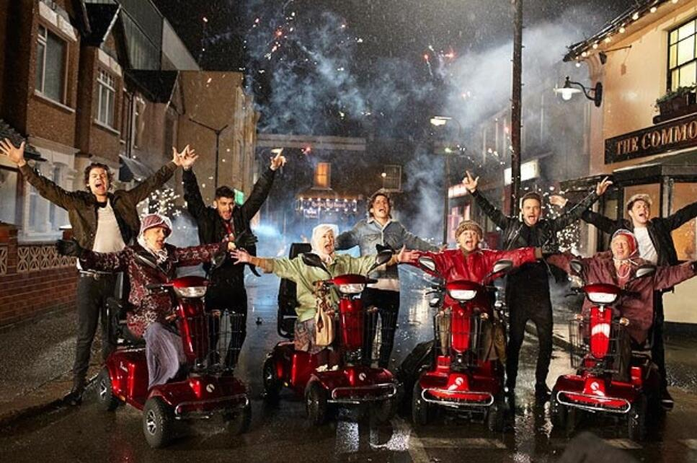
Scooter Rental
Wednesday 11/5 - Saturday 11/9
Arriving earlier than Wednesday?
Scooters are available as early as Sunday 11/2.
Booking begins October 1, 2025.
Convention attendees will have the opportunity to order beginning October 1, either by phone or thru Scooter company’s website portal.
Rentals $75/day inclusive.
Ordering information will be available in September.
Questions?
Email ICCBusinessAsst@harmonyinc.org

Slide 26
Activities

Slide 27
IBOD Installation and Reception
NEW THIS YEAR
We will have a designated time for our IBOD Installation followed by a reception.
Wednesday, November 5 @ 3:00 – 4:00 pm
Aztec Room

Slide 28
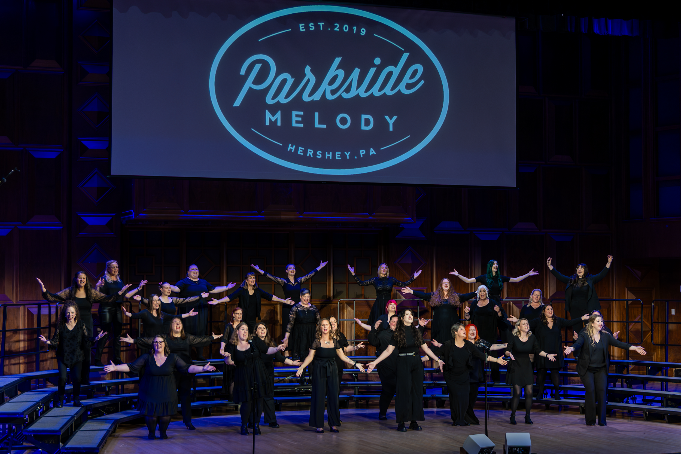
Opening Celebration
Annual membership meeting
Introduction of the Board and Assistants
Awards
Raffle
  Win a FREE Night’s Stay at Hershey Lodge!
  You MUST BE PRESENT to win.
Lots of singing!
Special entertainment by
  Parkside Harmony
  Parkside Melody
Join us for a night of music, joy, and chocolate-infused harmony.
We’ll kick off our International Convention and Contests with a celebration as rich as a barbershop chord and as sweet as a Hershey's Kiss.
We'll honor incredible members and blend our voices in true Harmony, Inc. style - all set against the deliciously delightful backdrop of Hershey, PA.

Slide 29

Tag Contest
The Tag Contest your chance to shine in the most fun, spontaneous way possible!
Grab 3 friends (any voicing!)
Learn & sing a tag
Register your group with a creative name
Win prizes — and the coveted Tag Contest Champion title!
No quartet? No problem! We’ll help you make music with new friends.
Thursday @ 8:00 pm
Aztec room

Slide 30


Slide 31
Saturday Showcase
All members and guests are invited to the annual showcase event.
It’s a great way to close out IC&C as we recognize and hear from our top medalists.
Anyone attending the dinner will have assigned seating to ensure they get the best seats.
For all others seating will be on a first come, first served basis.

Slide 32



Education Classes
IC&C is more than just contests and singing. We are fortunate that our talented members and panel volunteer of their time to help us all become Harmony Stronger.
Be sure to take advantage of this opportunity during IC&C. Classes will be offered on Thursday and Saturday mornings.
Once the classes are finalized, they will be posted on the IC&C page of our website and mobile app.

Slide 33
Volunteer

Slide 34

Volunteering
Meet new people, see contestants preparing themselves for the stage as they go through the pattern, and get a different perspective on the convention.
Form opens in September (after draw)
Browse through the many volunteer opportunities.
Find a job that interests you and fits with your schedule,
Try something new (and remember what happens behind the scenes at IC&C, stays behind the scenes at IC&C 😉)

Slide 35
Volunteer Opportunity Examples
Seat Counter: After the Opening Ceremony, stick around the ballroom and help the Registration Manager number the VIP seats. You’ll be done in under 30 minutes.
Showcase Dinner Assistant: Direct members to their tables at the Saturday night banquet. Only half-hour job.
Education Classes: Attend an education class, introduce the presenter, and take a headcount. At the end of the class give presenter a 5 min. warning and let them know when time has expired. You’re already taking the class, why not try something new.
Door Monitors: Open and close the doors into the contest hall so the contest flows smoothly and there are no disruptions during a performance. You may take turns sitting inside and outside the contest hall with the other monitors, so you’ll see part of the contest.
Pattern Escort: Escort contestant(s) from warm-up room to stage door.
Warm-up Room Monitor: Greet incoming contestants. Keep track of the time allotted to each contestant and give them a 2-minute warning before it’s time to move to the stage.

Slide 36
IC&C Resources
Notes:
Go to ICC website and show highlights of website content

Slide 37

Questions

